Slide 1
Self Embedding Watermarking System
Advisor: Dr. Asif Mahmood Gilani
Arbab Hamd Rizwan (18L-0765)
Usama Aslam (18L-0972)
Aashar Naseem (18L-1131)
M. Hunzlah Malik (18L-1139)

Slide 2
Outline
Introduction
Problem Statement
Our Solution
Type of Project
Goals
Scope
Overview of System
GUI
Constraints and Limitations
Work Breakdown and Timelines
Summary

Slide 3
Introduction
What is watermarking?
Active Forensics
Image Tampering
Video Tampering
Temporal Tampering
Spatial Tampering
Image Reconstruction
Video Reconstruction
Notes:
Not same as adding logo over image but its DIGITAL WATERMARKING
Temporal Tampering: Manipulating frame sequence
Spatial Tampering: Manipulating objects in frame

Slide 4
Problem Statement
Due to the availability of various editing software to tamper with any image or video, the authenticity of such media can be questionable.
This can create authenticity issues in various areas such as:
Evidence for prosecution in criminal cases
Copyrights on social media content
Online scams
Notes:
Online scam as in editing someone’s image/video and conspiring against them (scandal)

Slide 5
Our Solution?
The main concern gathered from our problem statement includes authentication and recovery of watermarked content. To deal with this problem, our team is developing a watermarking system which not only detect the image and video tampering but also restore them.

Slide 6
Type of Project
Our project is mainly focused on digital image processing with the following aspects:
Research & Development project
Research aspect
Digital Image Processing
Multimedia Security
Web application

Slide 7
Primary goals
Implement active forensics
Authentication of image and video.
Restore watermarked images and videos.
Our future goals may include:
Implementing passive forensic
Adding AI for tamper detection through neural networks

Slide 8
Scope
The scope of our project includes the following features
Usage of python to embed watermark in an image and keyframes of video
Running scripts on server side
Image processing libraries
Selection of keyframes algorithm

Slide 9
Overview of System
The self embedded watermarking system has the following main features which explain its working:
The user will use the web application to watermark an image or video.
The user will be given the option to download the watermarked image or video.
The user can then authenticate the image/video at any time after it has been watermarked.
Our system can reconstruct a tampered image or video that has been watermarked.

Slide 10
Overview of System (Contd.)
There are some important requirement for the execution of the program which are:
Tentative maximum upload size for an image or video is 50MB
The user shall upload a square image having NxN dimensions
The image processing scripts will run at server side
The server shall handle the processing load

Slide 11
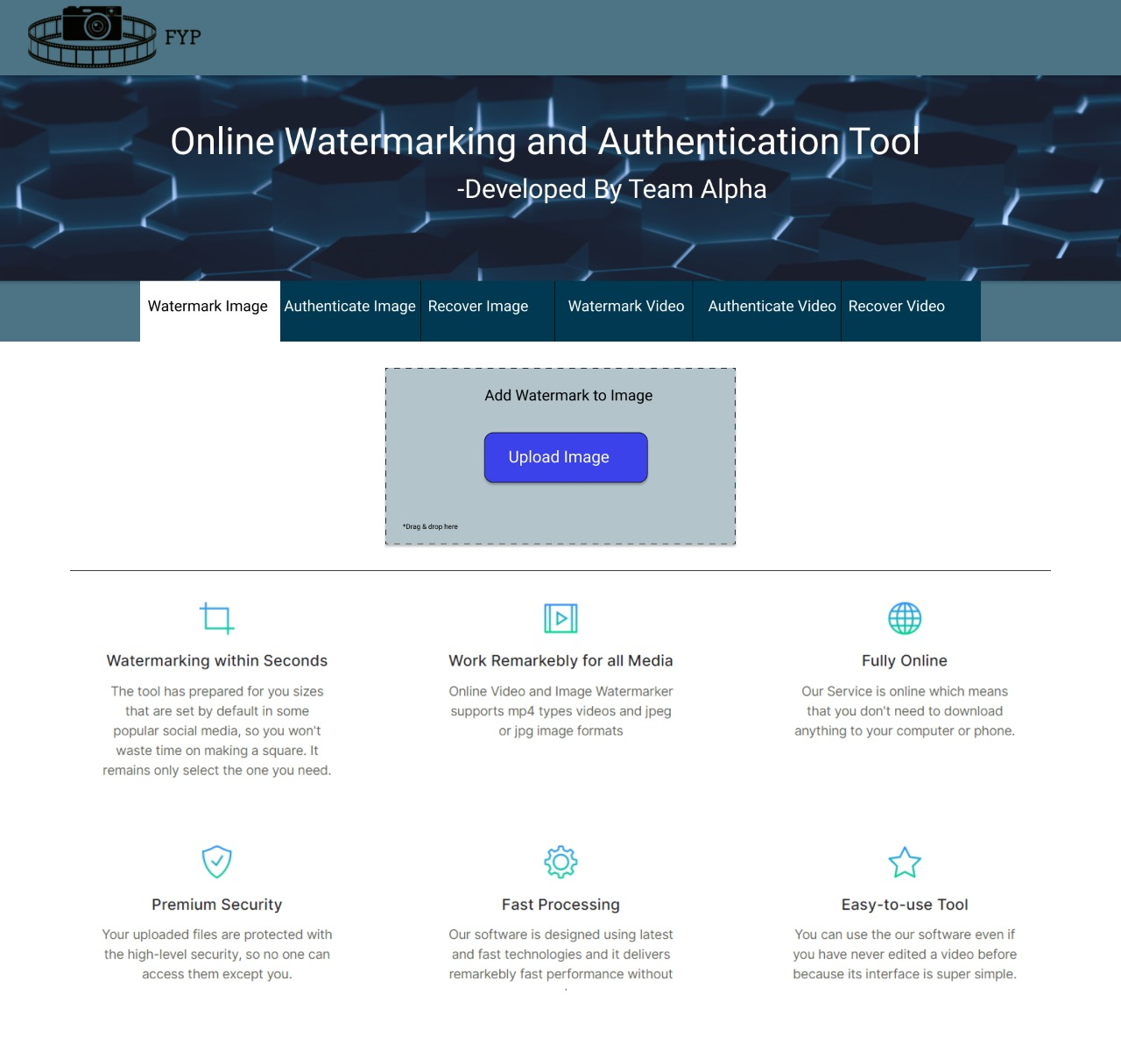
GUI

Slide 12
Constraints
Limitations
User requests may end up in a queue due to server load.
System can detect and recover 75% of tampered image.
System can detect and recover 10%-67% of a tampered video.
Limited upload size of image and video.
System will work on square images of nxn dimension.
Keyframe will also need to be a square image.
Key required for authentication and recovery.
Notes:
Reasons behind the constraints? Size limit: load no server, more queue delay
NxN: The division is in terms of equal blocks so we need square to work with algo.
75% is till best (as far as we know) recovery percentage. Avg is 50%
The static lookup table is used after many testing that these blocks positions are best

Slide 13
Work Breakdown and Timeline
Authentication and recovery of video
Nov 2021
GUI
Initial Research
Dec 2021
Embedding process
Jan 2021
Authentication and recovery of image
Feb 2021
Testing
Implementation of keyframe extraction
March 2021
May 2021
Testing
Deployment
Notes:
Most important step is embedding therefore, we will spend the longest time on it

Slide 14
Summary
Importance of image and video authentication
Usage in different fields such as forensics, social media content
Research aspect of our project

Slide 15
Thank you!
Any Questions?

